Slide 1

Content Filter
Dr Donia Gamal T.A Lamis Hassan
FCIS-ASU
Computer Science
2023-2024
1
Notes:
ثبح

Slide 2

Team Members :
Andrew Adel Andrews
Mariz Erian Ibrahim
Monica Sameh Azer
Filobateer Essam Motamed
Veronica Emad William
Mehrael Ashraf Rahif
2
Notes:
عرف التيم

Slide 3













AGENDA
01
02
03
04
05
06
07
Problem Statement
Motivation & Statistics
Background
Related Work
Objective
Benefits & Applications
Introduction
08
09
10
11
12
13
14
Literature Review
Datasets
Phase Description & System Architecture
Tools
Time Plan
Conclusion
References
3
Notes:
ودي الأجندات

Slide 4

Introduction
The internet is a crucial part of daily life, providing a wealth of information but also hosting inappropriate and harmful content.​ ​
Our project proposes developing a content filtering system to effectively block inappropriate content (such as cyberbullying, violence) while allowing access to legitimate content.​
4
Notes:
- الانترنت بقا جزء مهِم من حياتنا بحكم انه سهل علينا حاجات كتير - بس في نفس الوقت من سهولة نشر المحتوي بقت الناس تستغله في نشر محتوي مؤذي زي Cyberbullying و Content ممكن يكون Harmful لبعض الناس. - فا في محاولة مننا اننا نحد من انتشار Harmful content هنعمل Application يكون دوره انه يعمل بلوك للمحتوي الغير المناسب زي مثلا ال Cyberbullying والصور اللي ممكن تكون مؤذية للبعض

Slide 5


Problem Statement
In the era of digital communication, social media platforms have become a significant part of our daily lives.
However, these platforms are increasingly being used for harmful activities such as cyberbullying, hate speech.
The challenge lies in effectively filtering this content to ensure a safe and positive online experience for users.
5
Notes:
- في العصر الحالي الSocial media بقت شيء أساسي في حياتنا اليومية حتى في الدراسة والشغل مش بس الترفيه - بس للأسف بسبب الانتشار وان سهل أي حد يعمل Access بقينا نشوف تنمر و hate speech بحكم ان الناس مش بتحس بنفس القيود الاجتماعية اللي بتكون موجودة لما الكلام يكون موجه Face 2 Face - التحدي هنا اننا نعمل Filtering application يحافظ على امان و قيم المجتمع مع حفظ حرية الناس في التعامل مع الانترنت

Slide 6


Motivation
#1
Rising prevalence of harmful online content, particularly hateful speech and violence, on social media and educational platforms.​
#2
Negative impact on children's well-being, emphasizing the need for a safer online environment.​
6
Notes:
1-artfa3 nesab el harmful content zy el hateful speech aw violence f kol 7eta 7awalena eza kan on social media aw el edu. Platforms 2-el ta2sir el salby 7mait el atfal w 7fz bara2ethom w 5l2 safer environment

Slide 7
Statistics
Cyberbullying statistics for the past few years.
3.UNICEF
cyberbullying and digital harassment for the 70.6% of young people aged 15 to 24 years old who are online globally
[22]
4
2.UNESCO
The percentage of 13–17-year-old internet users reporting negative experience including cyberbullying was 77% in Argentina [23]
3
2
4.United Nations Human Rights
130 million students, 1 in 3 students from age 13 to 15 actually experience bullying [21]
1.A robust hybrid machine learning model for Bengali cyber bullying detection in social media[16]
1
surveys have indicated that women constitute 73.71% of cyberbullying victims
2016
2017
2019
2023
7
Notes:
Ahm statistics UNICEF 70.6% of young people from 15 to 24 globally et3arado l cyberbulling w harassment and UNHR
130 million stud 1 in 3 students from 13 to 15

Slide 8
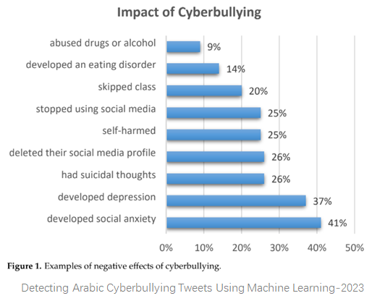
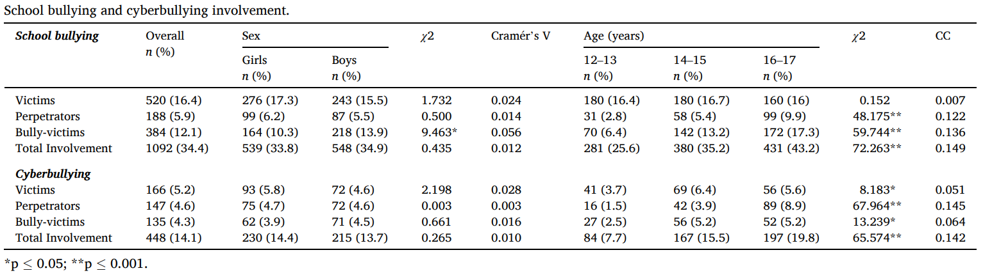
Analysis of the relationship between school bullying, cyberbullying, and substance use [15]
The studies are based on the involvement in school bullying and cyberbullying behavior
In global terms, 34.4% has been directly involved in any kind of school bullying role.
Results did not reveal differences between girls and boys in the roles of victims and perpetrators.
however, significant differences were obtained for the role of bully-victim, with significantly higher percentages among boys. By age range, no relevant differences in victimization rates were found, but there seemed to be a significant increase in perpetrators and bully-victims, reaching a threefold increase among 16–17-year-olds.
[14]
8

Slide 9
Background
Harmful Content Definition
Any content that can cause emotional,
psychological, or physical harm to individuals.
This includes text and images containing
threats, insults, offensive language,
or any form of aggressive behavior online.
Traditional ML Approaches
Need Labels and a lot of training time
Doesn't give the best results specially at
multiclass classification methods
Harmful Content Categories
Images Filtering Categories:[6]
Accidents
Murder
Robbery
Other
Text Filtering Categories: [13]
Offensive
Hate speech
Neither
Deep Learning Approaches
Needs larger datasets to give better results at
shorter time
Use Large Language models (NLP Transformer)
More flexible than Traditional approach and more trending for example GPT3 and its
implementation in the application ChatGPT
13
Notes:
We started off by defining what can be classified or defined as harmful content and these are the guidelines that define what is harmful content…. The Classes that harmful content in different datasets is classified as…..
We classified the approaches that we collected from our literature survey into 2 parts the 1st Traditional ML approaches which are …..
And 2nd Deep Learning Approach….
Cyber hate refers to any form of harassment, discrimination, or abuse that occurs on the internet or through digital communication platforms. It involves the use of electronic devices and the internet to spread hatred, hostility, and harm towards individuals or groups based on their race, ethnicity, religion, gender, sexual orientation, or any other characteristic.
Cyber bullying refers to the act of using digital communication tools, such as social media, text messages, or emails, to harass, intimidate, or harm someone. It involves repeated and intentional negative behavior, such as spreading rumors, posting hurtful comments, or sharing embarrassing content online. (mentioned in related work)

Slide 10
Background cont.
Eras of traditional and trending ML approaches
2016 – 2017 [1],[2]
Different supervised classification models used:
Bagging classifier, Random Forest, SGD, Linear SVC, Logistic regression, AdaBoost Classifier, Decision tree, Multinomial Naïve Bayes (MNB), KNN classifier
2016 - 2017
2021 - 2023
2020 [4]
LSVM FKNN
CSVM CKNN
QSVM CrKNN
CGSVM
MGSVM
FGSVM
2020
2021 - 2023 [6],[10],[13]
BERT, Logistic Regression, SVM, KNN, Naïve Bayes, Decision tree
14
Notes:
From our research we divided the models used into 3 eras:
from 2016 - 2017 the commonly used models were ….
starting from 2021- 2023 that the large language models started populating and
cubic SVM (CSVM)
Linear SVM (LSVM)
Quadratic SVM (QSVM)
Coarse Gaussian SVM (CGSVM)
Medium Gaussian SVM (MGSVM)
Fine Gaussian SVM (FGSVM)
---------------------------------------
Fine KNN (FKNN)
Cosine KNN (CKNN)
Coarse KNN (CrKNN)

Slide 11

Related Work
Social media platforms such as Facebook, Twitter, YouTube, Ask.fm, and Instagram are the top five networks where users have reported experiencing cyberbullying.
Cyberbullying is defined as the use of the Internet, cellphones, or other devices to send or post text or images with the intent to hurt or embarrass another person.
This issue is widespread; a recent report by the National Crime Prevention Council revealed that over 40% of teenagers in the United States have reported being victims of cyberbullying. [17]
The situation is equally alarming in Britain, where a study found that nearly half of suicides among young people are related to bullying. [17]
9
Notes:
Mention that the difference between our application and the present applications is that we will not allow the harmful images to be displayed based on the age of the user and if the user wants to see any filtered image there will be a verification method (OTP, Key, Token,…..)

Slide 12
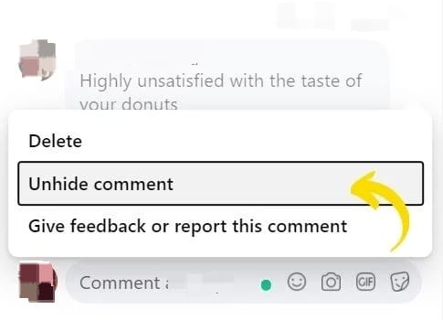
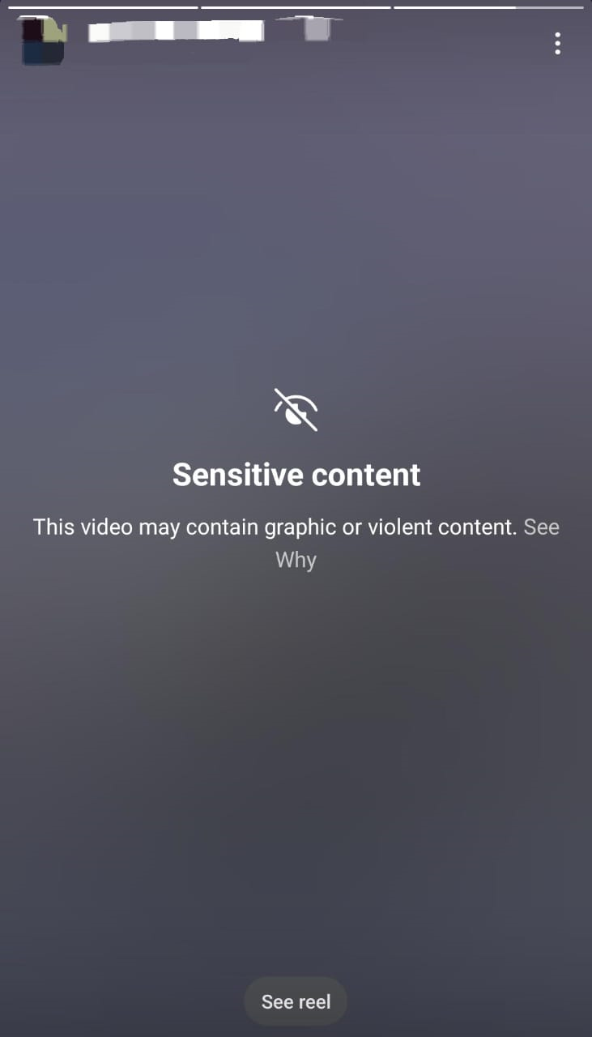
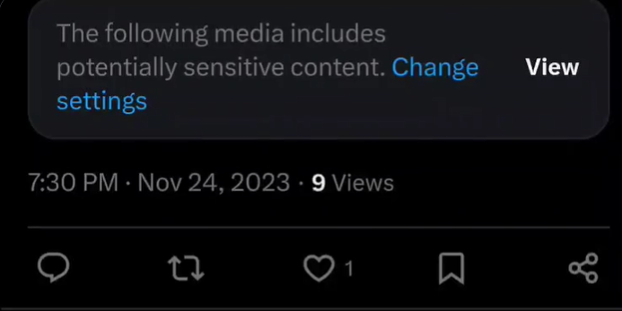
Related Work cont.
Examples from real life social media.
Facebook
Instagram
X (Twitter)
10
Related Work cont.
Platform Name | Guidelines | Observations From previous experience
Instagram [18] | Intellectual Property Appropriate Imagery Spam Illegal Content Hate Speech, Bullying and Abuse Self-Injury Graphic Violence | Even though Graphic content is filtered out there are posts that contain graphic and violence imagery that just get a warning and can be viewed. There are curse words written in a lot of posts and separated by a variety of symbols that don’t get removed
Facebook [19] | Violence and Criminal Behavior Objectionable content Integrity and authenticity | There are curse words written in a lot of posts and separated by a variety of symbols that don’t get removed
X (Twitter) [20] | Hateful references Incitement Slurs and Tropes Dehumanization Hateful Imagery Hateful Profile | There are curse words written in a lot of posts and separated by a variety of symbols that don’t get removed

Slide 13



Objectives
Create a tool that can filter text and images that run in the background.​
Apply Trending ML approaches, as the they will have a better impact on the datasets than traditional approaches as we will use it as real time application.
Achieve better performance by developing faster algorithms to get higher accuracy.
Investigate and address potential biases in the filtering system to ensure fair treatment of diverse perspectives and demographics.
11

Slide 14



Benefits & Applications
Contribute to the well-being of online communities by minimizing the spread of harmful content and fostering a healthier digital environment.​
​
Respect users' freedom of expression while addressing the challenges associated with content filtering, harmonizing freedom of expression and mutual respect​.
Community Well-being
Safety and freedom
Child Safety
Enhance online safety for children by preventing their exposure to harmful and inappropriate content on various platforms.
12
Notes:
Based on our motives… our tool aims to create a safer environment for all users and specifically for children by limiting and preventing their exposure to any harmful and inappropriate content online. We aim to achieve all this all the while ensuring the users’ freedom of speech and expression.

Slide 15
Literature Review
Authors | Dataset | Focus of paper | Models used | Results
Rubio, J. L. S., Almeida, A. V., & Segura-Bedmar, I. (2023)[6]. | dataset comprising 2,996 Spanish tweets related to violent acts | Detection of Violent Incidents on Social Networks (Text) | BERT | 0.918 F1-score
Escalante-Hernandez, A., Joaquín-Arellano, L., Lavalle-Martínez, J. D. J., Villaseñor-Pineda, L., & Jair Escalante, H. (2023) [11] | DA-VINCIS dataset of 5000 tweets in Mexican and Spanish | Identification of violent incidents using social networks (Text) | MLP | 0.65 F1- Score
Pericherla, S., & Ilavarasan, E. (2023)[4]. | MS-COCO , Flickr30K | Cyberbullying detection in image (images) | RoBERTa | Accuracy 88.82%
15
Notes:
Based on all the papers we read that use modern machine learning approaches, we came out with these models from the most recent papers (2023)
In Text domain:
Bert was the best model as it scored 91.8% → journal: CEUR Workshop Proceedings in the second place MLP (Multi-Layer Perceptron) with 65% → journal: Computacion y Sistemas
In Image domain:
RoBERTa (A Robustly Optimized BERT Pretraining Approach) with 88.82% → journal: International Journal of Computing and Digital Systems

Slide 16
Literature Review Cont.
# | Model Name | Accuracy | Image / text | Reference
1 | Decision Tree | 99.90% | Text | [1]
2 | Multinomial Naïve Bayes (MNB) | 64.00% | Text | [1]
3 | AdaBoost Classifier | 45.50% | Text | [1]
4 | Logistic regression | 77.70% | Text | [1]
5 | Linear SVC | 97.00% | Text | [1]
6 | Stochastic gradient descent optimizer (SGD) | 92.80% | Text | [1]
7 | Random Forest | 99.00% | Text | [1]
8 | Bagging classifier | 93.80% | Text | [1]
9 | Medium Gaussian SVM | 98.73% | Image | [8]
10 | KNN | 82.26% | Image | [8]
11 | Logistic regression & SVM | 75.00% | Text | [13]
12 | decision tree, SVM & Naive | 91.00% | Text | [13]
13 | Combinational Network for Bullying Detection(CNBD) | 91.40% | Image | [4]
16
Notes:
First 12 rows ➔ Traditional machine learning models, achieved good accuracy but we will go on with modern ML approaches as it gives better results @ shorter time
13. CNBD is a combination of 2 neural networks which are Binary Encoder Image Transformer (BEiT) and Multi-Layer Perceptron (MLP)

Slide 17
Datasets
Dataset Name | Data Type | Size | Classes
Twitter Dataset [13] | Text | 24,783 tweet. | Hate speech Neither | Offensive
FormSpring [1] | Text | 12,000 posts or 12,770 messages. | Bullying | non-bullying
DA-VINCIS corpus [6][10] [11] | Text | 5000 tweet. | Accident Homicide Robbery | Kidnapping Non-Violent-incident
CIFAR-100 [3] | Image | 80 million image. | Bicycle Bus… | Motorcycle
Kitti [2] | Image | 7481 image. | Car Pedestrian | Misc. Cyclist…
MS-COCO [4] | Image | 4000 image. | Person Car… | Bicycle
17
Notes:
CIFAR - 100 has a lot of classes that we don’t need so we will work on the ones that are related to our project
Formspring ➔ Binary Classes
Formspring dataset is a collection of messages from the social networking site Formspring that is annotated with classes of either bullying or non-bullying.

Slide 18
Phase Description
Load Data
Preprocessing
Training the Model
Classification
(Prediction)
Evaluation
Splitting Data
Text & Image
18

Slide 19
System Architecture
Preprocessing
Image
Resizing
Normalization
Noise Reduction
Segmentation
Tokenization
Stop words removal
Stemming
Lemmatization
Text
19
Notes:
Image ➔ Image Processing techniques
Text ➔ NLP techniques
Resizing: to reduce the computational cost of image processing algorithms or to fit images into a specific display or storage format.
Normalization: Normalization is the process of scaling the pixel values of an image to a fixed range. This is done to make the image more consistent and easier to analyze. Normalization is often used in machine learning and computer vision applications to improve the performance of algorithms.
Noise Reduction:. Noise can be caused by various factors such as low light conditions, sensor limitations, or compression artifacts. Noise reduction techniques can help to improve the quality of an image and make it easier to analyze.
Segmentation: Segmentation is the process of dividing an image into multiple segments or regions. This is done to identify objects or areas of interest in the image. Segmentation is often used in computer vision applications such as object detection, image recognition, and medical imaging.
Feature Extraction: Feature extraction is the process of extracting relevant information or features from an image. This is done to reduce the dimensionality of the image data and make it easier to analyze. Feature extraction is often used in machine learning and computer vision applications to improve the performance of algorithms.

Slide 20
System Architecture cont.
ML Models
Traditional Approaches
Feature Extraction
Train the model
Classification
(Prediction)
Evaluation
Classification
(Prediction)
NLP Transformers
Evaluation
20

Slide 21



Tools
Web-application
Programming Language
Libraries
Python
TensorFlow
Keras
NumPy
Sklearn
NLP Transformer
Development Tools
BERT
Roberta
T5
YOLO v3
IntelliJ
Kaggle Notebook
21
Notes:
Libraries:
TensorFlow and Keras are used to for creating Deep learning networks
NLP Transformer:
The NLP transformers we found from our literature survey and research that the most used transformers were BERT, RoBERTa and T5 but we will also try out other BERT variations as well.

Slide 22
Time Plan
Seminar 1
Seminar 2
Seminar 3
29 Nov
Nov
Dec
Jan
Feb
Mar
Apr
May
Jun
Jul
Survey and Learning
Requirement Specification
Project Analysis
Project Design
Implementation
Project Testing
Maintenance
Enhancement
Documentation
22

Slide 23

Conclusion
In conclusion, content filtering is a crucial aspect of internet security that helps protect users from harmful and inappropriate content by creating a safe space for users to speak their minds respectfully.
Our project aims to develop a content filtering system that could be used to filter out unwanted content from the internet. An intensive research has been done to gather more than one dataset and scientific papers that will be used as a reference for our project.
23
Notes:
In conclusion our project aims to filter all unwanted content to create a safe space for the user.

Slide 24
References
[12] Choqueluque-Roman, David, and Guillermo Camara-Chavez. "Weakly supervised violence detection in surveillance video." Sensors 22, no. 12 (2022): 4502.
[13] Bharadwaj, Vedadri Yoganand, Vasamsetti Likhitha, Vootnoori Vardhini, Adari Uma Sree Asritha, Saurabh Dhyani, and M. Lakshmi Kanth. "Automated Cyberbullying Activity Detection using Machine Learning Algorithm." In E3S Web of Conferences, vol. 430, p. 01039. EDP Sciences, 2023.
[14] Alduailaj, Alanoud Mohammed, and Aymen Belghith. "Detecting arabic cyberbullying tweets using machine learning." Machine Learning and Knowledge Extraction 5, no. 1 (2023): 29-42.
[15] Pichel, Rafael, Sandra Feijóo, Manuel Isorna, Jesús Varela, and Antonio Rial. "Analysis of the relationship between school bullying, cyberbullying, and substance use." Children and youth services review 134 (2022): 106369.
[16] Akhter, Arnisha, Uzzal Kumar Acharjee, Md Alamin Talukder, Md Manowarul Islam, and Md Ashraf Uddin. "A robust hybrid machine learning model for Bengali cyber bullying detection in social media." Natural Language Processing Journal 4 (2023): 100027.
[17] Singh, Vivek K., Qianjia Huang, and Pradeep K. Atrey. "Cyberbullying detection using probabilistic socio-textual information fusion." In 2016 IEEE/ACM International Conference on Advances in Social Networks Analysis and Mining (ASONAM), pp. 884-887. IEEE, 2016.
[1] Sahana, V., Anil Kumar KM, and Abdulbasit A. Darem. "A Comparative Analysis of Machine Learning Techniques for Cyberbullying Detection on FormSpring in Textual Modality.“
[2] Chen, Menghuan, Jiarong Liang, Jingyao Shu, and Ren Zhu. "A Hierarchical Accident Recognition Method for Highway Traffic Systems." In Journal of Physics: Conference Series, vol. 2456, no. 1, p. 012034. IOP Publishing, 2023.
[3] Khan, Muhammad Attique, Usman Tariq, Taerang Kim, and Jae-Hyuk Cha. "Anomalous Situations Recognition in Surveillance Images Using Deep Learning.“
[4] Pericherla, Subbaraju, and E. Ilavarasan. "Overcoming the Challenge of Cyberbullying Detection in Images: A Deep Learning Approach with Image Captioning and OCR Integration." International Journal of Computing and Digital Systems 14, no. 1 (2023): 1-xx.
[5] Vijeikis, Romas, Vidas Raudonis, and Gintaras Dervinis. "Efficient violence detection in surveillance." Sensors 22, no. 6 (2022): 2216.
[6] Rubio, Jorge Luis Saavedra, Alejandro Valbuena Almeida, and Isabel Segura-Bedmar. "UC3M at Da-Vincis-2023: using BETO for Detection of Aggressive and Violent Incidents on Social Networks." In Proceedings of the Iberian Languages Evaluation Forum (IberLEF 2023), CEUR Workshop Proceedings. CEUR-WS. org. 2023.
[7] Vallejo-Aldana, Daniel, Adrián Pastor López-Monroy, and Esaú Villatoro-Tello. "Enhancing Multi-modal Classification of Violent Events using Image Captioning." In Proceedings of the Iberian Languages Evaluation Forum (IberLEF 2023), CEUR Workshop Proceedings. CEUR-WS. org. 2023.
[8] Khan, Muhammad Attique, Usman Tariq, Taerang Kim, and Jae-Hyuk Cha. "Anomalous Situations Recognition in Surveillance Images Using Deep Learning.“
[9] Ahmed, Md Tofael, Nahida Akter, Maqsuder Rahman, Dipankar Das, Touhidul AZM, and Golam Rashed. "" MULTIMODAL CYBERBULLYING MEME DETECTION FROM SOCIAL MEDIA USING DEEP LEARNING APPROACH." International Journal of Computer Science and Information Technology (IJCSIT) 15 (2023): 27-37.
[10] Ponce-León, Esteban, and Irvin Hussein López-Nava. "CICESE at DA-VINCIS 2023: Violent Events Detection in Twitter using Data Augmentation Techniques." In Proceedings of the Iberian Languages Evaluation Forum (IberLEF 2023), CEUR Workshop Proceedings. CEUR-WS. org. 2023.
[11] Escalante-Hernandez, Alejandro, Luis Joaquín-Arellano, Jose de Jesús Lavalle-Martínez, Luis Villaseñor-Pineda, and Hugo Jair Escalante. "Towards the Monitoring of Violent Events in Social Media through Visual Information." Computación y Sistemas 27, no. 1 (2023): 153-162.
[18] Instagram Community Guidelines FAQ’s.
[19] Facebook Community Standards | Transparency Center.
[20] X's policy on hateful conduct | X Help.
[21] Copyright © United Nations Human Rights.
[22] Copyright © UNICEF.
[23] Copyright © UNESCO.
24

Slide 25

Thank you
Any questions ?

Slide 26
Objectives
Caption
Models
The user can demonstrate on a projector or computer, or presentation and make it film to be used in a wider field
Apply both Traditional and Trending ML Approaches and observe their impact on the datasets
4
Models
Caption
1
3
Performance
Unbiased & Fairness
Unbiased & Fairness
2
Performance
Investigate and address potential biases in the filtering system to ensure fair treatment of diverse perspectives and demographics. Implement measures to minimize the impact of biases in content moderation.
Achieve better performance by developing faster algorithms to get higher accuracy

Slide 27
System Architecture
Content Filter
Text
Preprocessing
Training the Model
Classification
Prediction

Slide 28
System Architecture cont.
Content Filter
Image
Preprocessing
Resizing
Normalization
Noise reduction
Segmentation
Feature Extraction
Training the model
Classification
Prediction

Slide 29
Motivation
01
02
Profound impact on internet users, especially children.​
01
02
Creating a positive online environment.​
03
04
03
04
Empowering parents and educators with a robust content filtering system.​
Safety focus for children across diverse all internet platforms.​

Slide 30


Harassment Statistics
Based on Age Group
The percentage of harassment out of each age group
24-39 Year Olds
52%
51%
18-23 Year Olds
Online Hate and Harassment

Slide 31
Model name | Accuracy | Image / Text | Reference
Decision tree | 99.90% | Text | [1]
Multinomial Naïve Bayes (MNB) | 64.00% | Text | [1]
AdaBoost Classifier | 45.50% | Text | [1]
Logistic regression | 77.70% | Text | [1]
Linear SVC | 97.00% | Text | [1]
Stochastic gradient descent optimizer (SGD) | 92.80% | Text | [1]
Random Forest | 99.00% | Text | [1]
Bagging classifier | 93.80% | Text | [1]
Medium Gaussian SVM | 98.73% | Image | [8]
KNN | 82.26% | Image | [8]
Logistic regression & SVM | 75.00% | Text | [13]
decision tree, SVM & Naive | 91.00% | Text | [13]
CNBD | 91.40% | Image | [4]
BERT | 91.86% | Text | [3]

Slide 32
Procedure
This is a placeholder. Theme fonts recommended.
Title
Here
Title
Here
Title
Here
Title
Here
The user can demonstrate on a projector or computer, or print the presentation and make it into a film to be used in a wider field The user can demonstrate. The user can demonstrate on a projector or computer, or print the presentation and make it into a film to be used in a wider field The user can demonstrate.

Slide 33
Objectives
1
2
3
4
Reducing the spread of harmful content: Content filtering projects aim to identify and remove harmful content from social media platforms and other online spaces. This can include hate speech, violent content, and other forms of harmful or inappropriate material.​
Improving platform safety: By removing harmful content and promoting positive discourse, content filtering projects can help improve the overall safety of social media platforms and other online spaces.​
Create a tool that can filter text and images that run in the background .​
Incorporate NLP, Image processing and machine learning.​

Slide 34
4
Summary & Advice
The user can demonstrate on a projector or computer, or print the presentation and make it into a film to be used in a wider field The user can demonstrate
PART FOUR

Slide 35
Contributions Cont.
#4
Parent Control Feature:
To be able to notify parents of any suspicious behavior regarding their child's online activity.
#5
Sarcasm detection:
To be able to detect sarcastic as well as offensive content and filtering it out, in this process we will need to combine between multiple datasets to be able to get a dataset that contains both points, also we will aim to achieve higher accuracy percentage.
#6
Multilingual Content Filtering:
Extend the filtering system to support multiple languages. This can involve training models on diverse language datasets and addressing the challenges of language-specific content moderation.
Our main focus will be combining between the Arabic and English language and detecting the inappropriate and violent content to filter out

Slide 36
2
Status Quo
The user can demonstrate on a projector or computer, or print the presentation and make it into a film to be used in a wider field The user can demonstrate
PART TWO

Slide 37
3
Procedure
The user can demonstrate on a projector or computer, or print the presentation and make it into a film to be used in a wider field The user can demonstrate
PART THREE

